Slide 1
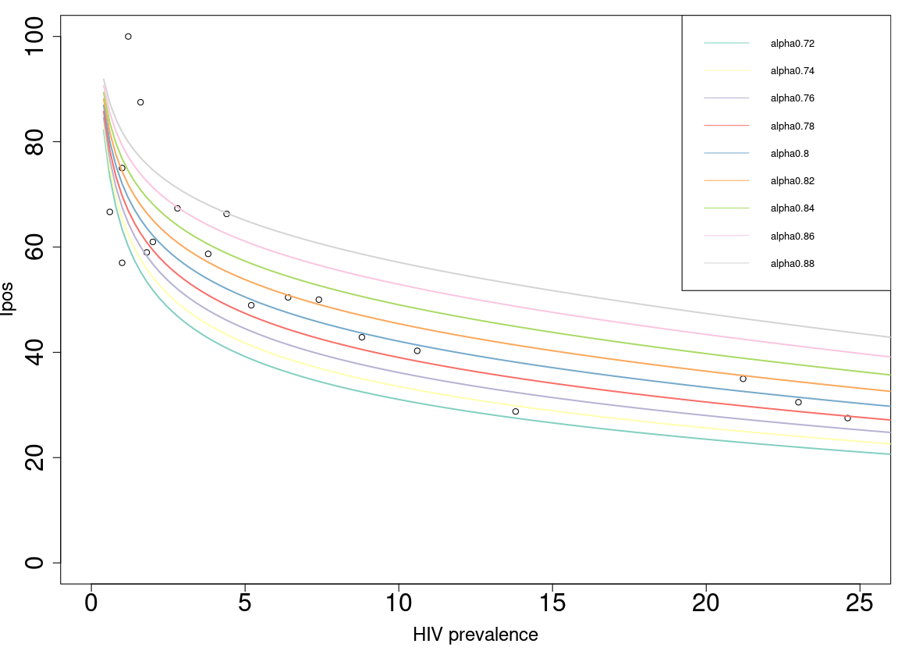
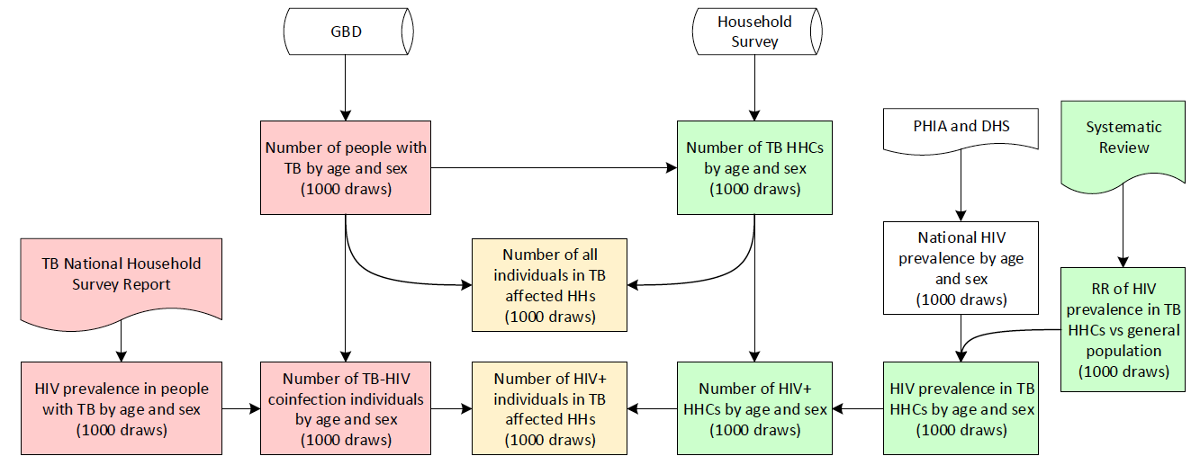
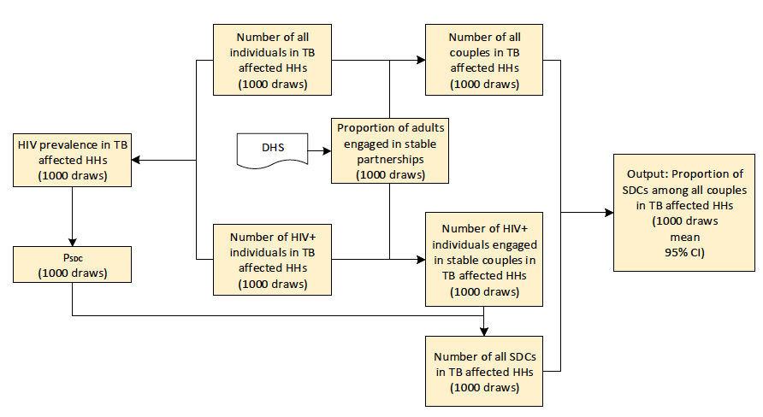

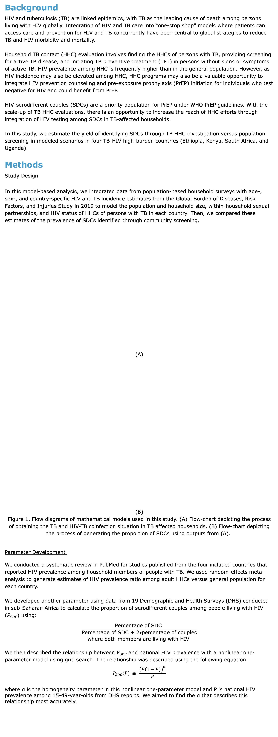
Modeled estimates of HIV-serodifferent couples in tuberculosis-affected households in sub-Saharan Africa Meixin Zhang¹, Ashley S. Tseng², Godwin Anguzu³, Ruanne V. Barnabas⁴, J. Lucian Davis⁵, Andrew Mujugira⁶, Abraham D. Flaxman¹, Jennifer M. Ross⁷ ¹Institute for Health Metrics and Evaluation, University of Washington, Seattle, USA; ²Department of Epidemiology, University of Washington, Seattle, USA; ³Department of Social Science Research Institute, Duke University, Durham, USA; ⁴Division of Infectious Diseases, Massachusetts General Hospital, Boston, USA; ⁵Department of Epidemiology of Microbial Diseases, Yale School of Public Health, New Haven, USA; ⁶Infectious Diseases Institute, Makerere University, Kampala, Uganda; ⁷Division of Allergy and Infectious Diseases, University of Washington, USA
Background
HIV and tuberculosis (TB) are linked epidemics, with TB as the leading cause of death among persons living with HIV globally. Integration of HIV and TB care into “one-stop shop” models where patients can access care and prevention for HIV and TB concurrently have been central to global strategies to reduce TB and HIV morbidity and mortality.
Household TB contact (HHC) evaluation involves finding the HHCs of persons with TB, providing screening for active TB disease, and initiating TB preventive treatment (TPT) in persons without signs or symptoms of active TB. HIV prevalence among HHC is frequently higher than in the general population. However, as HIV incidence may also be elevated among HHC, HHC programs may also be a valuable opportunity to integrate HIV prevention counseling and pre-exposure prophylaxis (PrEP) initiation for individuals who test negative for HIV and could benefit from PrEP.
HIV-serodifferent couples (SDCs) are a priority population for PrEP under WHO PrEP guidelines. With the scale-up of TB HHC evaluations, there is an opportunity to increase the reach of HHC efforts through integration of HIV testing among SDCs in TB-affected households.
In this study, we estimate the yield of identifying SDCs through TB HHC investigation versus population screening in modeled scenarios in four TB-HIV high-burden countries (Ethiopia, Kenya, South Africa, and Uganda).
Methods
Study Design
In this model-based analysis, we integrated data from population-based household surveys with age-, sex-, and country-specific HIV and TB incidence estimates from the Global Burden of Diseases, Risk Factors, and Injuries Study in 2019 to model the population and household size, within-household sexual partnerships, and HIV status of HHCs of persons with TB in each country. Then, we compared these estimates of the prevalence of SDCs identified through community screening.
(A)
(B)
Figure 1. Flow diagrams of mathematical models used in this study. (A) Flow-chart depicting the process of obtaining the TB and HIV-TB coinfection situation in TB affected households. (B) Flow-chart depicting the process of generating the proportion of SDCs using outputs from (A).
Parameter Development
We conducted a systematic review in PubMed for studies published from the four included countries that reported HIV prevalence among household members of people with TB. We used random-effects meta-analysis to generate estimates of HIV prevalence ratio among adult HHCs versus general population for each country.
We developed another parameter using data from 19 Demographic and Health Surveys (DHS) conducted in sub-Saharan Africa to calculate the proportion of serodifferent couples among people living with HIV (P_{SDC}) using:
$$\frac{\text{Percentage} \text{of} \text{SDC} }{\begin{aligned}\text{Percentage} \text{of} \text{SDC}\text{ + 2∗}\text{percentage} \text{of} \text{couples} \\ \text{where} \text{both} \text{members} \text{are} \text{living} \text{with} \text{HIV} \end{aligned}}$$
We then described the relationship between P_{SDC} and national HIV prevalence with a nonlinear one-parameter model using grid search. The relationship was described using the following equation:
$$P_{SDC}\left(P\right) ≅ \frac{{\left(P\left(1−P\right)\right)}^{α}}{P}$$
where α is the homogeneity parameter in this nonlinear one-parameter model and P is national HIV prevalence among 15-49-year-olds from DHS reports. We aimed to find the α that describes this relationship most accurately.
Finally, we estimated the number of HIV acquisitions that could be averted through PrEP use among SDC in TB-affected households in scenarios where 25%, 50%, 75%, and 100% of partnerships would be eligible using parameters from a PrEP demonstration study. We used a Monte Carlo approach to propagate uncertainty levels throughout the model.
Results
The literature search for the HIV prevalence among adult household members of people with TB resulted in 502 PubMed records for screening and selection of 10 research studies that met all inclusion criteria. Two publications were in Kenya, six were in South Africa, and two were in Uganda. In Kenya (prevalence ratio [PR]=4.12; 95% uncertainty interval [UI]: 1.50, 11.31) and Uganda (PR=1.86; 95% UI: 1.54, 2.23), the HIV prevalence in TB HHCs was higher than the HIV prevalence in the general population. In South Africa, the HIV prevalence was similar to the general population (PR=1.14; 95% UI: 0.72, 1.81). In Kenya, the heterogeneity of study estimates led to a wide UI.
Figure 2. Simulated relationship between PSDC and HIV prevalence using α between 0.7 and 0.9
In the process of describing the relationship between PSDC and HIV prevalence (P), we found the best homogeneity parameter, α. As shown in Fig. 2, each data point represents one 𝑃𝑆𝐷𝐶−𝑃 pair extracted from DHS reports. In this step, we found that 𝛼 = 0.82 minimizes the least square.
Table 1. The HIV prevalence and the SDCs in TB-affected households
We estimated the HIV prevalence among adults aged 15-49 living in TB-affected households to be higher than in the general population in all 4 countries (Table 1). The proportion of serodifferent couples among all couples in TB-affected households was also higher than in the general population in 4 countries (Table 1).
Table 2. HIV acquisitions averted through PrEP among serodifferent couples in TB-affected households
Finally, we estimated that up to 1,836 (95% UI: 1,304-2,358) HIV acquisitions in South Africa could be prevented annually by PrEP use in serodifferent couples in TB-affected households, 927 (95% UI: 413-1,464) in Kenya, 709 (95% UI: 523-893) in Uganda, and 415 (95% UI: 304-531) in Ethiopia.
Conclusions
We estimate that couples in TB-affected households are more likely to be serodifferent than couples in the general population in TB-HIV highburden settings. Offering PrEP during household TB contact evaluation may prevent a substantial number of HIV acquisitions.
Funding Source: This research was funded in part by a developmental grant from the University of Washington/Fred Hutch Center for AIDS Research, an NIH-funded program under award number AI027757 which is supported by the following NIH Institutes and Centers: NIAID, NCI, NIMH, NIDA, NICHD, NHLBI, NIA, NIGMS, NIDDK.
Country | HIV prevalence in TB affected HHs | HIV prevalence in general population | Prevalence of SDC in TB affected HHs | Prevalence of SDC in the general population
Kenya | 19.40 (6.03-34.83) | 4.5 (4.1-4.9) | 15.89 (7.10-22.67) | 5.7 (4.4-7.0)
Uganda | 15.32 (13.47-17.16) | 6.0 (5.7-6.3) | 13.65 (12.43-14.85) | 6.0
Ethiopia | 2.82 (2.59-3.03) | 0.9 (0.8-1.0) | 3.85 (3.59-4.14) | 0.8 (0.6-1.0)
South Africa | 31.74 (23.98-39.46) | 20.6 (19.9-21.3) | 20.68 (17.97-22.82) | 15.7 (12.2 – 19.2)
 | Percentage of partnerships would be eligible for PrEP because the partner living with HIV was not virally suppressed
 | 100% | 75% | 50% | 25%
Kenya | 927 (413 - 1464) | 695 (310 - 1098) | 464 (207 - 732) | 232 (103 - 366)
Uganda | 709 (523 - 893) | 532 (392 - 670) | 355 (262 - 447) | 177 (131 - 223)
Ethiopia | 415 (304 - 531) | 311 (228 - 398) | 208 (152 - 266) | 104 (76 - 133)
South Africa | 1836 (1304 - 2358) | 1377 (978 - 1769) | 918 (652 - 1179) | 459 (326 - 590)

